Slide 1






E-COMMERCE SALES ANALYSIS
Student Details
NAME: BARANI P
NM ID: autleee011
COLLEGE NAME: VARUVAN VADIVELAN INSTITUTE OF TECHNOLOGY

Slide 2
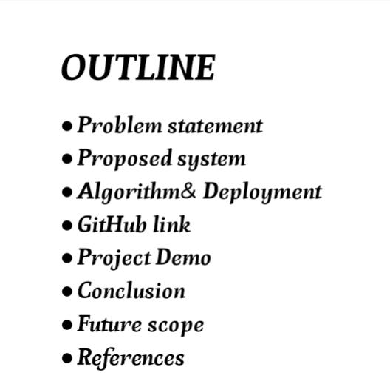


Slide 3
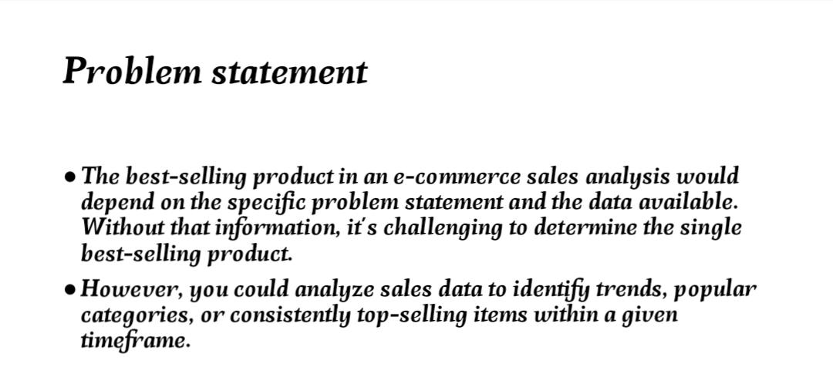



Slide 4
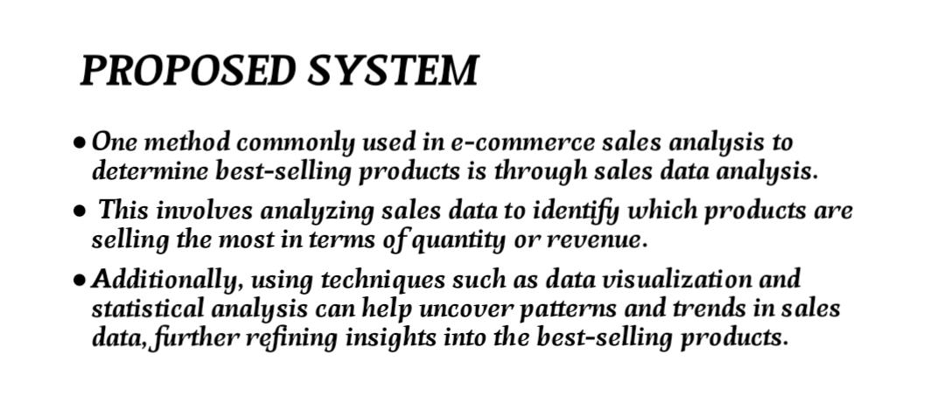



Slide 5
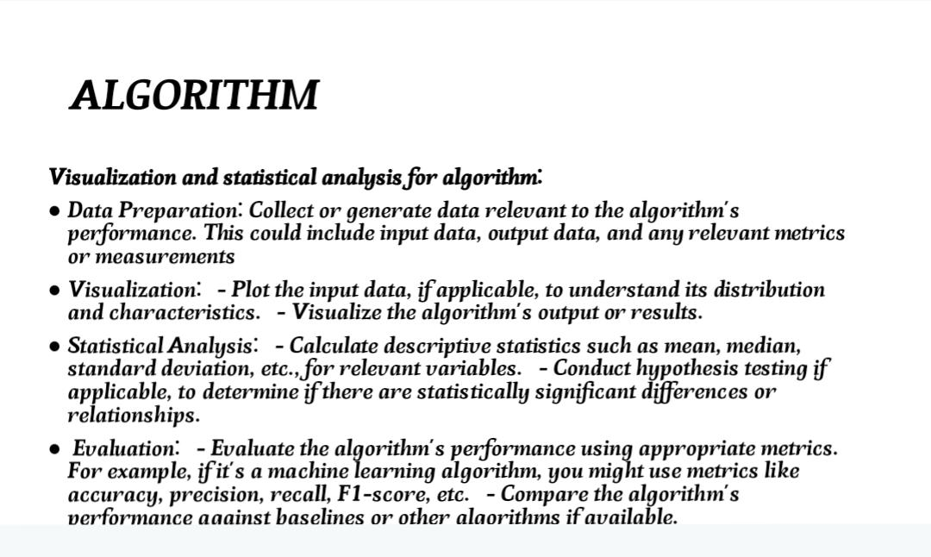

Aim and Objective

Slide 6
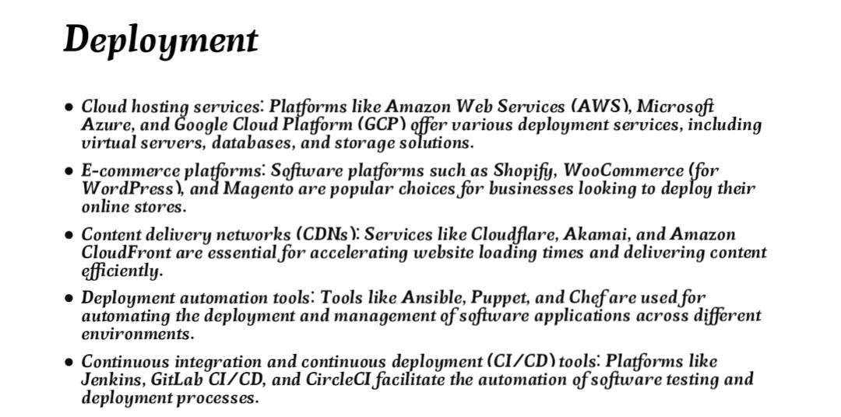

Slide 7
GITHUB LINK :
https://github.com/Baranip777
Notes:
7

Slide 8
PROJECT DEMO
https//github.com/Baranip777/Barani_E-commerce
Notes:
8

Slide 9
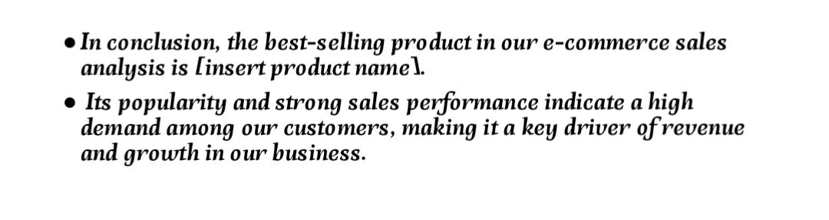

CONCLUSION :
Notes:
9

Slide 10

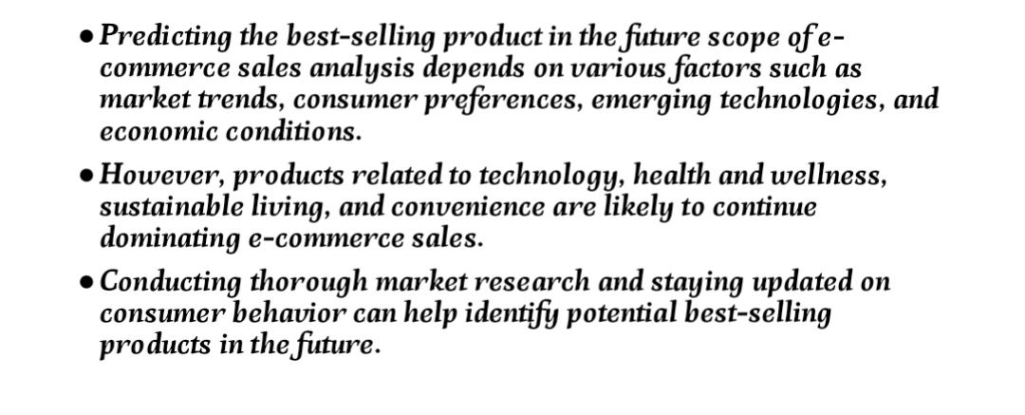
Future Scope
Notes:
10

Slide 11
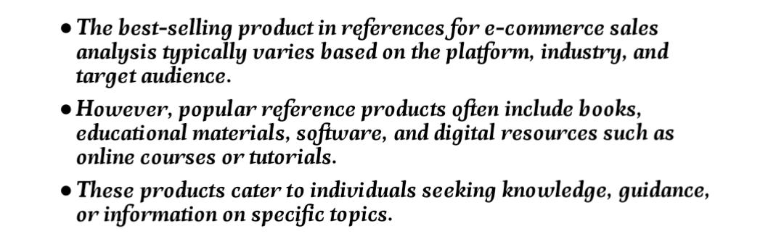
REFERENCS
Notes:
Reference
These are the references for this session.

Slide 12
Thank you!
Notes:
12

